Slide 1

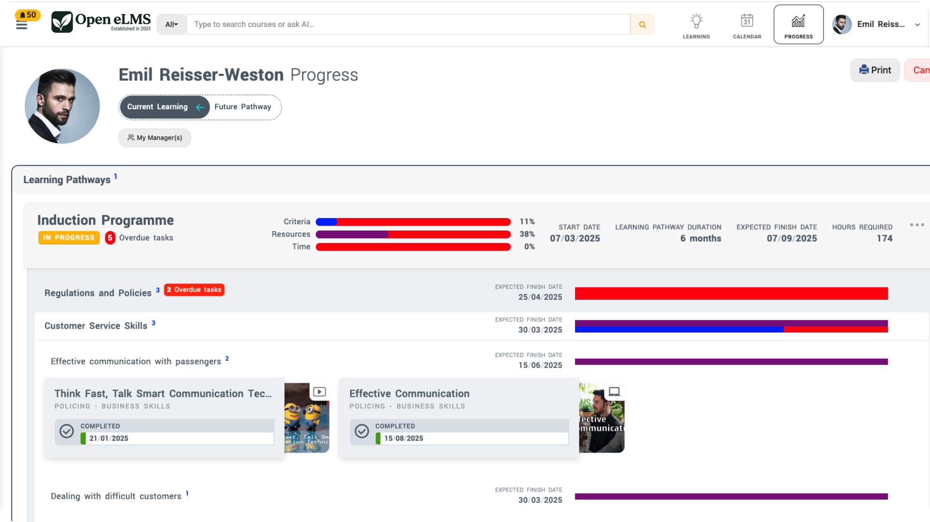
An LMS that creates real transformation through automation and AI… achieves 100x more
Emil Reisser-Weston, MSc MEng
Managing Director, Open eLMS
Notes:
Hello. I’m here today to talk to you about Open eLMS: an LMS that creates real transformation in your business through automation and AI, achieving 100 times more on key tasks with existing resources and letting you do things you would never have considered before. That’s only possible because ours is the most comprehensive learning management system available, built through 23 years of non-stop development and innovation.

Slide 2
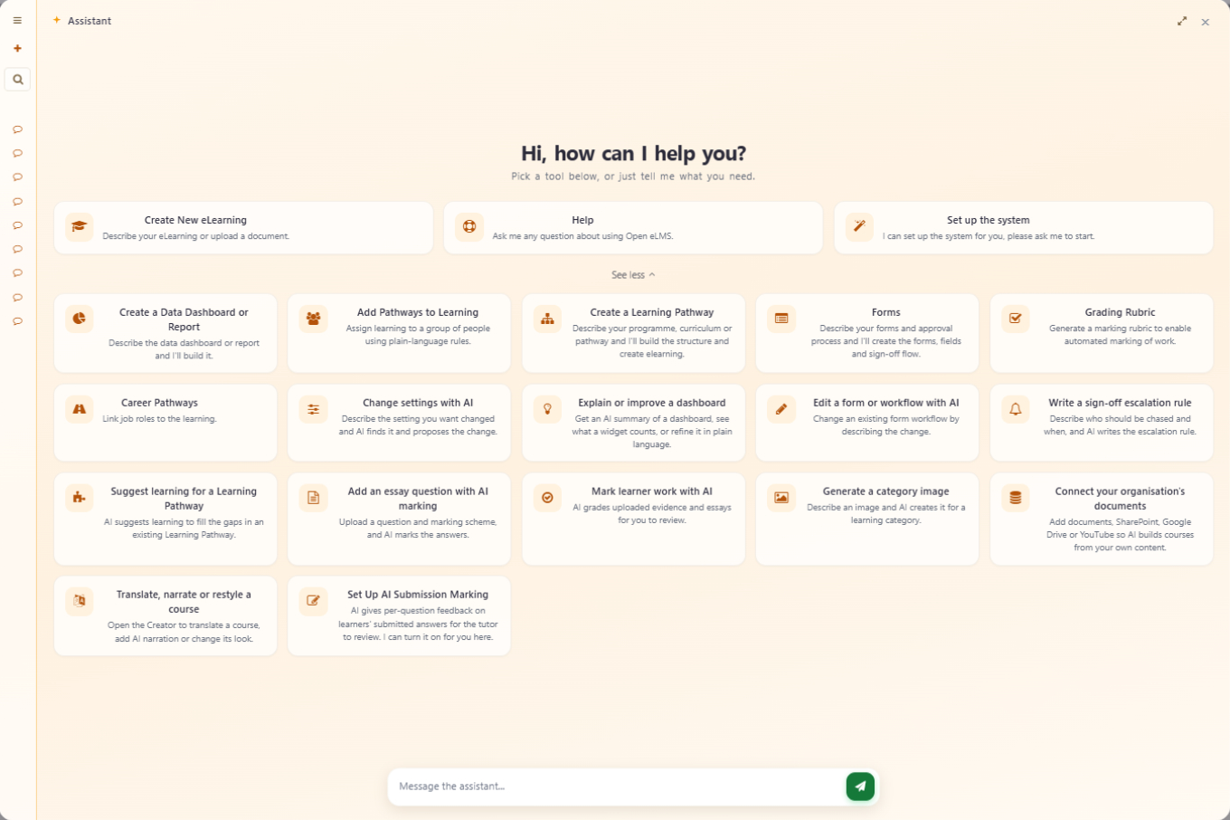
Let’s upload a document
BEFORE WE BEGIN
Any PDF, policy or procedure. We’ll come back to it at the end of the talk.
openelms.com
Notes:
I can show you just how this is possible with an example. Here I’m uploading an example PDF document into Open eLMS. We’ll come back to it later.

Slide 3

Background
PART ONE
Why one company built such a comprehensive way to manage learning.
Notes:
To understand how this unique product was created, we need to take a very quick look at the background of the company. It explains why it has developed such a comprehensive solution to managing learning within organisations.

Slide 4
Two decades at the forefront of learning
OVERVIEW
LMS since 2003
Authoring system since 2007
Top Performer on SourceForge and Slashdot, Summer 2026
First LMS for apprentices
The only LMS that creates multimodal learning
One supplier for all your learning needs
23+
5,500+
Years of innovation
eLearning courses
99.9%
4.9
Uptime SLA
Capterra rating
openelms.com
Notes:
Open eLMS has been producing learning management systems since 2003, and our authoring system has been available since 2007. This summer SourceForge and Slashdot again named us a Top Performer, and we hold a 4.9-star rating on Capterra. We were the first learning management system built for apprenticeships, and we’re the only LMS that genuinely creates multimodal learning. We now have more than 5,500 eLearning courses, and we’re one supplier for all your learning needs, corporate or educational.

Slide 5




Everything from content to LMS
ONE SUPPLIER
The AI-powered LMS, 23 years in development.
eLearning, podcasts, videos, games and PowerPoint from prompts or documents.
More than 5,500 editable courses in 28 languages.
Project management, finance, marketing and HR beside your LMS.
openelms.com
Notes:
Open eLMS is one supplier for the whole learning solution: the LMS itself, the Learning Generator for creating content, the eLearning Store with more than 5,500 editable courses, and Open eLMS OS, which adds project management, finance, marketing and HR modules alongside your LMS.

Slide 6








Trusted across the public and private sectors
CLIENTS
Local government
Central government
Blue light services
Legal
Transport
Housing
Universities
FMCG
openelms.com
Notes:
Our client base cuts across many sectors, including local and central government, blue light services, legal, transport, housing, universities and large FMCG organisations. Recent implementations include Toronto Pearson Airport and Suffolk County Council.

Slide 7
Enterprise-grade security and compliance
CERTIFICATIONS & STANDARDS
ISO 27001
ISO 9001
ISO 20000
Information security
Quality
IT service management
Cyber Essentials Plus
CPD Certified
LTI v1.3
Security
Continuing professional development
Interoperability
UK Training Provider Number 10002082 · Approved government supplier with framework membership
openelms.com
Notes:
We hold ISO certification for information security, quality and IT service management, plus Cyber Essentials Plus and CPD accreditation, and we’re built to LTI v1.3. We’re also an approved government supplier with framework membership, which means we can sell our services directly to you, without a costly tendering process.

Slide 8
The journey
PART TWO
How we got to a genuinely game-changing solution in EdTech.
Notes:
So that is who we are. But how did we get to the point where we can offer you a genuinely game-changing solution in EdTech? To explain, you need to know the journey we’ve been on.

Slide 9
The first learning experience platform
THE JOURNEY
2003
We began as a bespoke eLearning developer and built an LMS around learners’ needs: a video-on-demand style that foreshadowed Netflix. In 2007 came browser-based authoring; today, eLearning from a document or prompt using AI.
to today
openelms.com
Notes:
We started in 2003 as a bespoke eLearning developer, producing high-quality eLearning with video presenters and green-screen technology, which was unique at the time. Many of our clients didn’t have learning management systems, so we built one for them. We designed it around the learner’s needs with no reference to other systems on the market, and that blank-slate approach produced something very like video-on-demand services such as Netflix, which it foreshadowed. In essence it was the first LXP, a learning experience platform: an LMS that takes the learner’s experience into account. In other words, a decently designed LMS. In 2007 we created an eLearning authoring system that ran in the browser, several years ahead of its time. It has since progressed to creating eLearning from an uploaded document or a text prompt using AI. With this feature, seeing really is believing.

Slide 10
Why reinvent the wheel?
A QUESTION
Systems to manage and create learning already existed.
Notes:
So why did we take this path? Why reinvent the wheel when systems already existed to manage and create learning?

Slide 11
Learning tech was broken by inertia
THE ANSWER
Notes:
Essentially, the learning technology industry was broken by its own inertia. It’s a pattern we’ve seen consistently over the last 23 years.

Slide 12

Clunky solutions
INDUSTRY FAILING 1 OF 3
Existing systems are designed around the data, not around the people who use them.
Result: training on how to use the training system.
openelms.com
Notes:
Existing solutions are consistently clunky in their design. The design is driven by the data rather than by the user experience.

Slide 13
Tools that produce e-reading
INDUSTRY FAILING 2 OF 3
Templated PowerPoint-style slides, or scrolling pages no different from a website. Nothing immersive.
Result: you may as well read a book.
openelms.com
Notes:
eLearning development tools are limited in what they can produce. Either they produce very structured, templated learning with images and text in a PowerPoint style, or they produce vertically scrolling content that is really no different from looking at a website. Essentially, they produce e-reading experiences. They aren’t immersive; you aren’t taken into a virtual world of learning. You’re reading content on a screen, and you may as well just read a book and watch a video.

Slide 14
Systems not adapting to client needs
INDUSTRY FAILING 3 OF 3
Personnel management
Skills management
eLearning creation
User friendly
Skills are linked to learning and should be monitored with it.
Selling a library with no books in it.
Learners shouldn’t have to learn the system.
Inductions, reviews and forms come before the learning.
openelms.com
Notes:
Learning management systems also don’t adapt to client needs; they’re limited in scope and ambition. Personnel management, such as progress reviews, inductions and completing forms, is a natural precursor to managing learning. Skills management, maintaining and monitoring the skills in an organisation, is naturally linked to learning and should be monitored with it. Organisations spend vast amounts on learning management systems that can’t produce the eLearning that should populate them: it’s like selling a library with no books. And learners shouldn’t have to learn how to use their learning system. An LMS should be intuitive in every way, from the act of learning to managing the data it produces.

Slide 15
A fresh approach was needed
OUR RESPONSE
Notes:
Clearly, a fresh approach was needed.

Slide 16
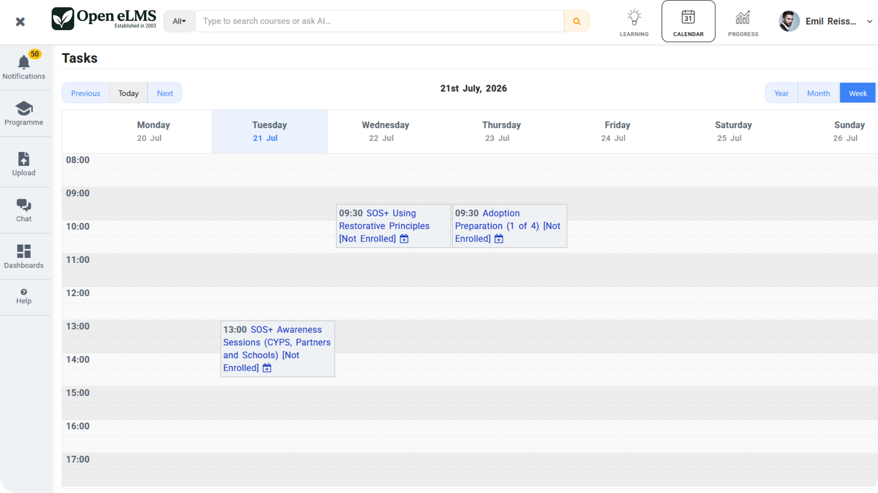
Nobody needs training to use Netflix
USER-CENTRED DESIGN · LEARNERS
Designed by an ergonomist over 23 years, so learners never need training on the system itself.
openelms.com
Notes:
Open eLMS adopted user-centred design. The system has been designed by an ergonomist, or human factors designer as the role is known in the States, over the last 23 years, and the design team has focused on making the experience intuitive in every way. Take Netflix: nobody has ever sold training on how to use Netflix. In the same way, nobody has ever sold training on how to use Open eLMS as a learner. And with the Dionysus release, AI can now generate a branded learner interface in whatever style suits your organisation: video on demand, governmental, carousel and more.

Slide 17
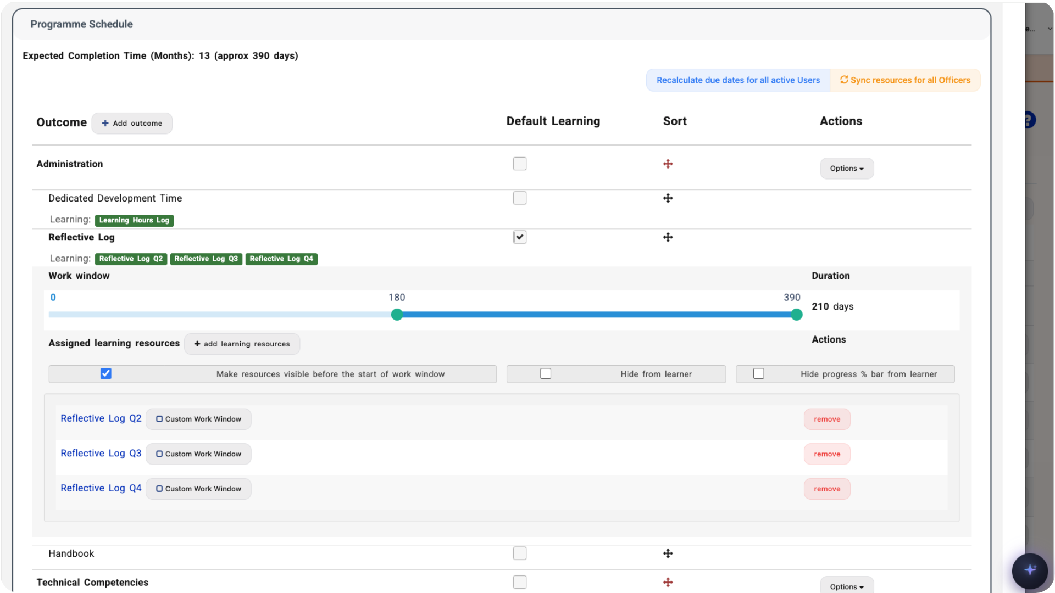
Read the screen left to right
USER-CENTRED DESIGN · MANAGERS
A unique interface for each management role, modelling the day’s work. One button to press on any screen.
openelms.com
Notes:
We can see the same user-centred design principles applied to the manager’s interface. Open eLMS has a unique interface for each management role. The user simply reads the screen from left to right, which models the day-to-day work they need to do. On any screen there’s only one button to press, so they don’t have to search the interface to work out how to use it: the design guides them. That minimises the need for training and means a whole organisation adopts the system quickly.

Slide 18
So complete it needs no customisation
COMPREHENSIVE
600+
Built to meet the requirements of almost any tender without programming changes or costly custom work.
configuration options
openelms.com
Notes:
Open eLMS also needed a comprehensive approach to LMS design. Our ambition was an LMS so comprehensive it needed no customisation, one that could meet the requirements of any tender without programming changes. By predicting market needs and including more than 600 configuration options, Open eLMS can meet the requirements of almost any project without costly changes from a programming team.

Slide 19



Just some of the hundreds of features
COMPREHENSIVE
Forms
Any device
Any language
Inductions and progress reviews feed straight into learning.
Including our own app for learning offline.
Content translated for every learner.
openelms.com
Notes:
Let’s look at just some of the hundreds of features Open eLMS has. The system produces forms, bringing induction information and progress reviews directly into the learning process. It works across all devices and even has its own app for offline learning. And content can be translated into any language.

Slide 20
An army of designers, programmers and support staff, on tap
INTEGRATED AI
Notes:
But what really puts us ahead of the game is how we’ve integrated artificial intelligence into the platform. It’s like having an army of designers, programmers, support staff and administrators on tap whenever you need them.

Slide 21
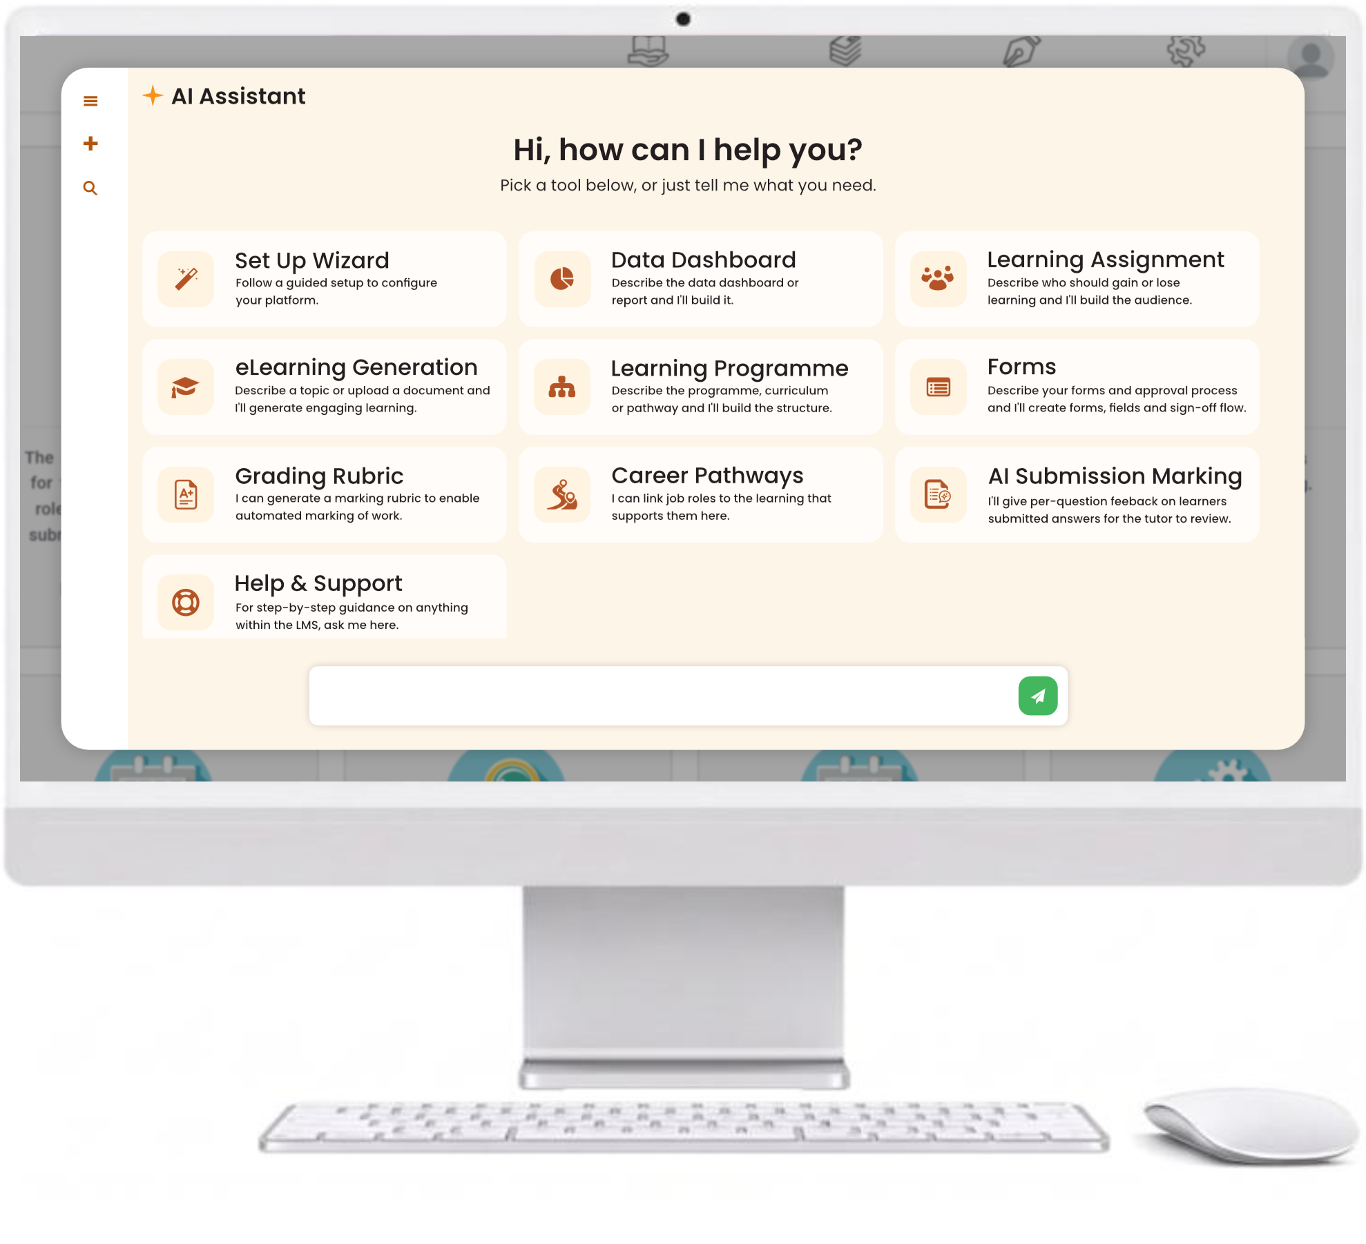
AI in every corner of the LMS
INTEGRATED AI & AUTOMATION
Multimodal eLearning from a document or prompt
An AI assistant with video walkthroughs
Course recommendations for every learner
Reports and dashboards from a plain-English request
AI marking of submitted work
openelms.com
Notes:
I’ve already shown you the first step of how Open eLMS produces its own multimodal eLearning from an uploaded document or text prompt: video presenters, voiceover that’s indistinguishable from a human voice, images, animations and screen design, all produced by AI. That’s the Open eLMS Learning Generator, a globally unique AI agent offered through Open eLMS. Open eLMS also has an AI assistant that answers any question while you use the software, with links to video tours; it’s like having an expert on hand at any time. AI also recommends learning that each learner will be interested in, builds reports and dashboards from a plain-English request, and marks submitted work.

Slide 22
A comprehensive learning solution
PART THREE · THE JOURNEY’S END
Notes:
So at the end of the journey, a journey that never really ends, we have a comprehensive learning solution.

Slide 23
Open eLMS Dionysus
CURRENT RELEASE · 2026
Skill Scan: map skills and see the gaps
AI chat powered by your own content
Skills-based pathways on the ESCO taxonomy
Automation through MCP and the API
An AI-generated learner interface, in your brand
Podcast, mind map, game and video exports
AI report creation and dashboard builder
Automatic course freshness and fact checks
openelms.com
Notes:
The current release of Open eLMS is Dionysus, released in 2026. It puts skills at the centre of learning, lets AI build and look after your content, and delivers every course in the format your learners prefer. Highlights include Skill Scan analysis to map your people’s skills and see the gaps; skills-based learning pathways built on the ESCO skills taxonomy; an AI-generated learner interface in any style, branded to your organisation; AI report creation and a dashboard builder; AI chat powered by your own LMS content; automation through MCP and the Open eLMS API; podcast, mind map, microgame, PowerPoint and video exports from every course; and automatic freshness and fact checks on courses.

Slide 24



Where traditional LMSs fail
THE PROBLEM
Only manage eLearning
Generic learning
Varying quality
Can’t adapt to wider needs
openelms.com
Notes:
Open eLMS, as always, addresses the failings of traditional systems. To recap: traditional learning management systems deal only with the learning. The learning itself is generic, samey eLearning and PDF files. Its quality varies widely and inconsistently, from courses bought in from providers to courses created in house (often the in-house learning is better). And the system is limited in its functionality and can’t adapt to wider client needs.

Slide 25

Open eLMS resolves these problems
THE ANSWER
Handles any type of learning
Totally configurable
Creates its own learning
The most complete feature set
openelms.com
Notes:
Open eLMS resolves these problems. It handles any type of learning, from video to uploaded work, essentially anything you can think of, and new custom learning types can be added. It’s totally configurable, with more than 600 configuration options; no two installations of Open eLMS are remotely the same. It creates its own learning: multimodal eLearning produced in minutes. And it has the most comprehensive feature set of any learning management system available today. We know that from the feedback on the tenders we frequently respond to in the UK.

Slide 26
Reasons not to move, and the truth
PART FOUR · BREAKING FALSE BELIEFS
Notes:
In any business transformation, there will be accepted truths about why you shouldn’t make a change, and many of them have no justification at all. I hope to show you the difference between the myths and the truth when it comes to changing your learning management system.

Slide 27

“We need a traditional enterprise system.”
MYTH 1 OF 7
THE TRUTH
Modern SaaS solutions are totally scalable, and secure by certification.
openelms.com
Notes:
Myth one: you need a traditional enterprise system. People accept that an enterprise solution is needed because of the scale of data and the security requirements of high-profile corporate data. The truth is that SaaS solutions built on modern architecture are totally scalable. Cloud infrastructure can be scaled up to meet any database and application requirement, and combined with well-defined security procedures and certifications, there’s no barrier to choosing your provider freely.

Slide 28
“Nobody gets fired for buying IBM.”
MYTH 2 OF 7
THE TRUTH
New approaches come from established players: 23 years of innovation.
openelms.com
Notes:
Myth two: nobody gets fired for buying IBM. This old saying describes choosing well-known suppliers for their reputation rather than for what their product does. The truth is that new approaches can come from established players. Open eLMS has been innovating in this field for more than 23 years, consistently delivering functionality five years ahead of the competition. And what Open eLMS offers you is a real business enabler; that can’t be hidden behind mediocrity any longer.

Slide 29
“I don’t trust AI-generated courses.”
MYTH 3 OF 7
THE TRUTH
AI works alongside human expertise, with full editorial control. Try it: you’ll be surprised.
openelms.com
Notes:
Myth three: I don’t trust AI-generated courses. The AI in Open eLMS works alongside human expertise; it doesn’t replace it. It produces top-quality eLearning while giving you full editorial control, and every course now gets automatic freshness and fact checks. Try creating learning using AI alone; you’ll be surprised at just how powerful it is.

Slide 30
“We’ll get our LMS from our HR supplier.”
MYTH 4 OF 7
THE TRUTH
Open eLMS integrates seamlessly with Workday, SAP and other third-party systems.
openelms.com
Notes:
Myth four: I’ll get my learning management system from my existing HR supplier, such as Workday or SAP. A learning management system is highly specialised software, and Open eLMS integrates seamlessly with third-party systems, so there’s no need to limit your requirements to the HR infrastructure you already have. You don’t buy your accounts software from Microsoft just because it makes the operating system. We produce the best learning systems available because we focus only on learning systems.

Slide 31
“My existing software will do this soon.”
MYTH 5 OF 7
THE TRUTH
Open eLMS has a history of delivering innovation five years ahead of the market.
openelms.com
Notes:
Myth five: my software will do this soon. Open eLMS has a history of delivering innovation five years ahead of the market. With AI, innovations come more often and bring their advantages faster than ever. We’re adding as many features to Open eLMS AI in a week as our competitors add in a year. Every day you wait counts.

Slide 32
“Moving from our LMS will be too difficult.”
MYTH 6 OF 7
THE TRUTH
We migrate all your data, history, HR records and learning, using pre-built queries.
openelms.com
Notes:
Myth six: moving from my LMS will be too difficult. Open eLMS can migrate all your data for you, including historical learning data, HR data and the learning itself, using pre-built queries. Your data can move from the legacy system to the new one in a very short time. There’s no need for any downtime while you switch; we’re well practised at doing it overnight.

Slide 33
“It would be too costly.”
MYTH 7 OF 7
95%
THE TRUTH
Open eLMS costs less than traditional enterprise systems, from £10 per user per year.
of cases
openelms.com
Notes:
Myth seven: it would be too costly. In 95% of cases, Open eLMS reduces costs compared with traditional enterprise systems. Buying Open eLMS is usually cost-neutral or better. You very rarely pay extra for things like customisation, because the system is so flexible and comprehensive, and our prices are published on our website, starting from £10 per user per year.

Slide 34
Why Open eLMS is different
PART FIVE · THE NEW OPPORTUNITY
Notes:
It’s important now to emphasise what this new opportunity is, and why Open eLMS is different from any solution you may have today.

Slide 35
Twelve things you get with Open eLMS
WHAT YOU GET
01 Personnel management: onboarding, reviews
07 Submit work: projects uploaded and marked
02 Live learning: webinars, classrooms, blended
08 Roles and permissions: 250 per role
03 eLearning library: 5,500+ courses
09 Custom reporting: Power BI and AI reports
04 AI course generator: eLearning in minutes
10 Help and support: training and AI help
05 Tracks any learning: video, web, documents
11 AI and automation: learning and career pathways
06 Skills monitoring: Skill Scan and refreshers
12 The LMS: manages all learning
openelms.com
Notes:
So what do you get with Open eLMS? Twelve things, and I’ll take you through each in turn.

Slide 36


Personnel management: onboarding and reviews
WHAT YOU GET · 01 OF 12
Custom forms
Custom reports
Sign-off workflow
Use LMS fields or create your own.
Export the form data into reports you design.
Model the hand-offs from one role to the next.
openelms.com
Notes:
First, Open eLMS gives you a personnel management system for tasks such as onboarding and employee reviews. You can create custom forms, using fields from the learning management system or your own. That information can then be exported into custom reports. And Open eLMS has a sign-off process, so the workflow of sign-off and data entry from one role to another can be modelled in the system. AI can even create the forms for you from a description.

Slide 37
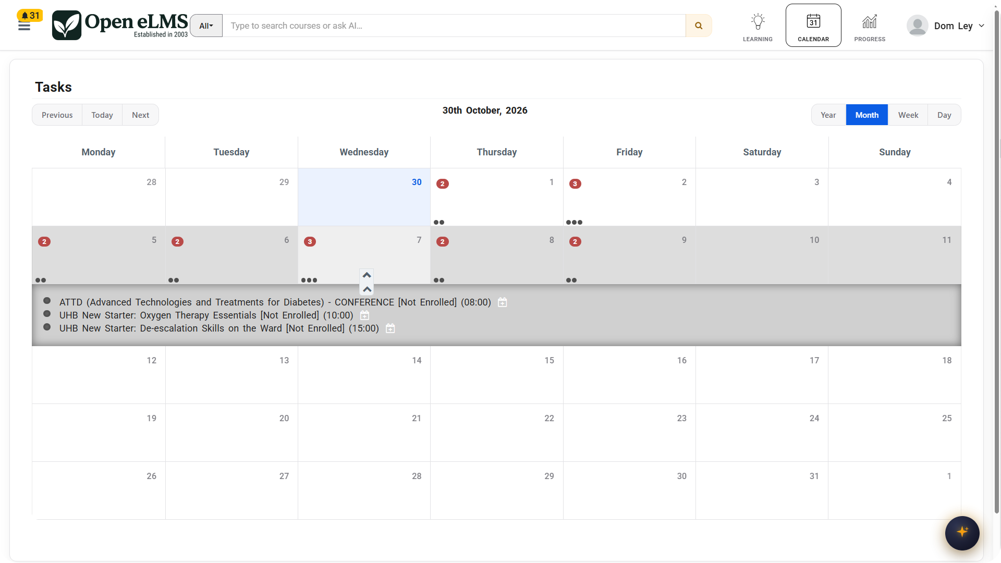
Live learning: webinars and classrooms
WHAT YOU GET · 02 OF 12
Schedule events, blend in eLearning, manage waiting lists and bookings. Teams and Zoom built in.
openelms.com
Notes:
Live learning events are also covered: webinars and classroom training can be scheduled, and online learning blended into those events and tracked. When you create an event, you can include eLearning as assignments or as presentation material tracked at the event, and assign learners. The system creates waiting lists and sends the right email notifications and reminders whenever an event is scheduled. Learners can book onto events, with costs added where appropriate, and details such as special requirements captured when they enrol. Microsoft Teams and Zoom sessions can be scheduled, recorded and tracked directly in the LMS.

Slide 38
eLearning library: ready to use
WHAT YOU GET · 03 OF 12
5,500+
Compliance, health and safety, management and IT skills, every course QA-checked and fully editable.
courses in 28 languages
openelms.com
Notes:
Open eLMS also includes an eLearning library, now more than 5,500 courses in 28 languages, covering compliance, health and safety, management and IT skills, and every one is QA-checked. Plans include eLearning credits, and Enterprise AI includes unlimited credits.

Slide 39
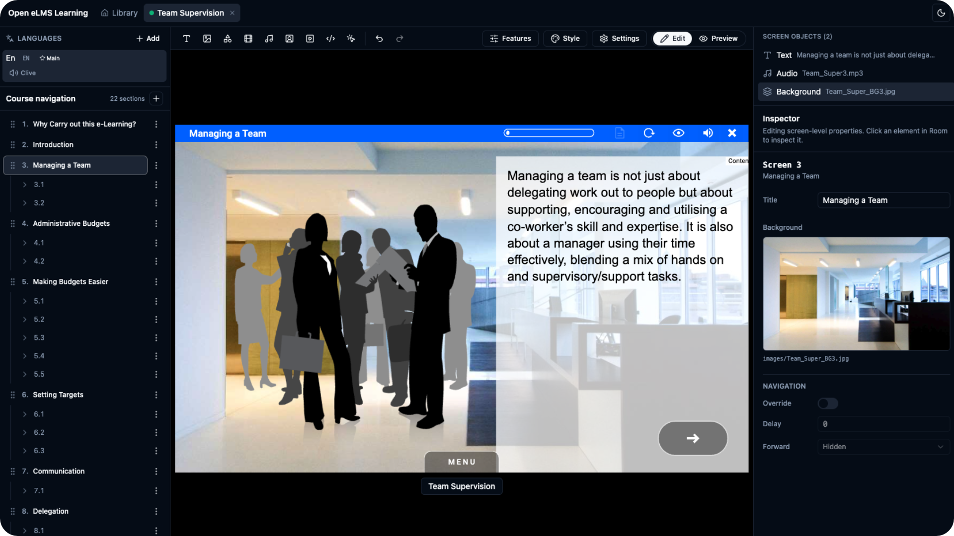
Every course is fully editable
WHAT YOU GET · 03 OF 12
Change text, branding and images in the online editor, or generate a new image with AI. 1,000+ animations included.
openelms.com
Notes:
Uniquely, every course is completely editable in the Open eLMS online editor: text, branding, imagery and more. Here we use AI to generate a new image when one is needed, however unusual the request, and Open eLMS can accommodate it. The finished course adds animations too. Open eLMS has a library of more than a thousand animations built up over 23 years, which both the AI and you can use, and a media library of more than 380,000 background images. You get 23 years of eLearning design experience inside a SaaS product.

Slide 40
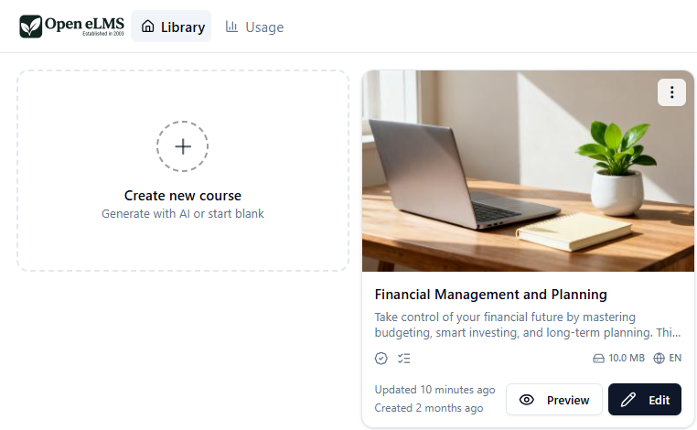
AI course generator: eLearning in minutes
WHAT YOU GET · 04 OF 12
From a prompt or a document: video presenters, learning goals, voiceover and design. A genuine game changer.
openelms.com
Notes:
Of course, Open eLMS also has an AI-powered course generator that produces multimodal eLearning in minutes. It’s a genuine game changer. From a text prompt or an uploaded document, it produces multimodal learning in minutes: here it produces a video presenter who sets out the learning goals.

Slide 41
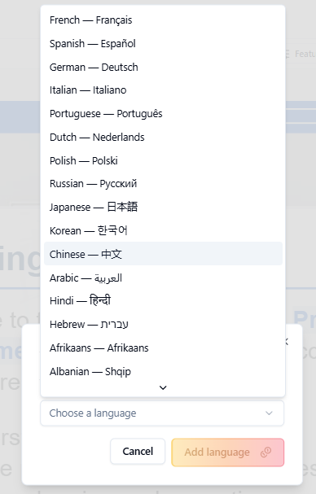
Any language, any question type
WHAT YOU GET · 04 OF 12
Translate the whole course, voiceover and presenters included. Quizzes take any question type:
Drag and drop · Fill in the missing word · Multiple choice · Multi-select · Matching pairs
openelms.com
Notes:
It also produces translations, including voiceover and presenters, in any language; we’ve had courses translated into Ukrainian, for example. The course includes quizzes, and you can add questions of any type, including drag and drop, fill in the missing word, multiple choice, multi-select and matching pairs.

Slide 42
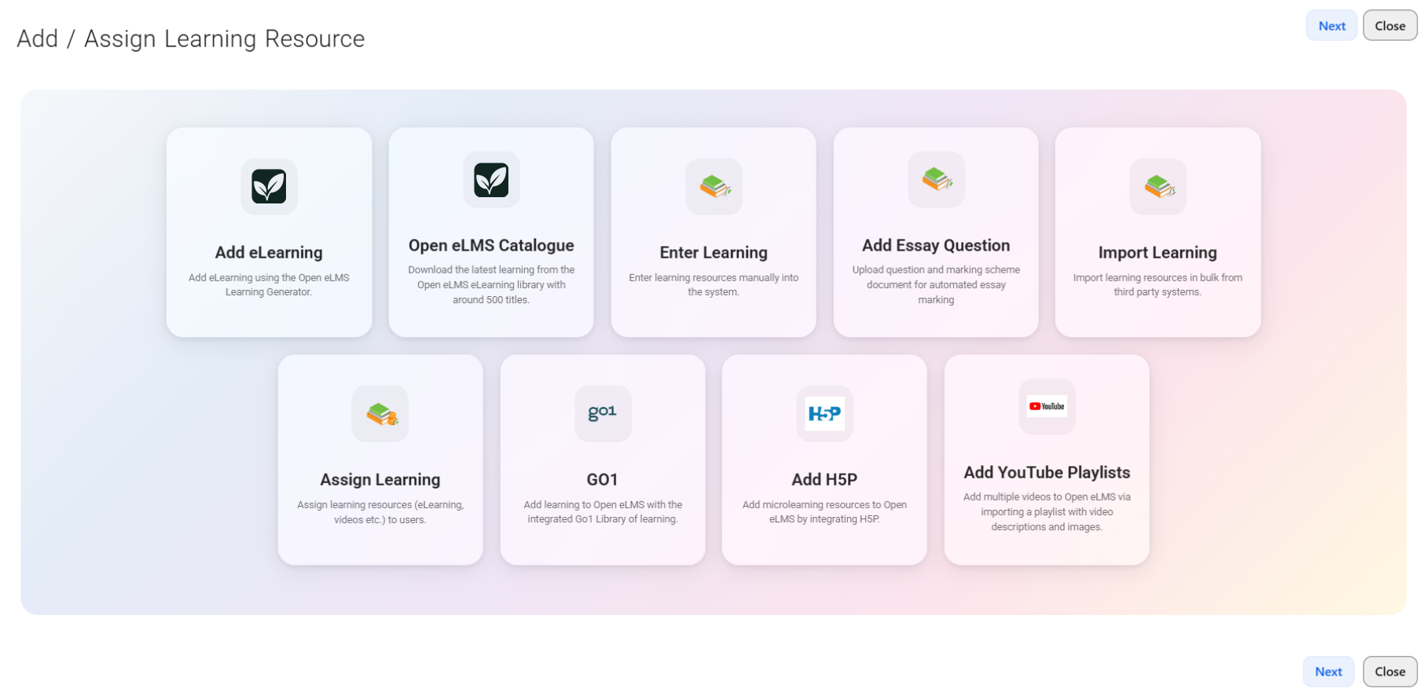
Tracks any learning
WHAT YOU GET · 05 OF 12
Videos, websites, documents, Go1, H5P, YouTube playlists and more, all filterable by type.
openelms.com
Notes:
Open eLMS also tracks any type of learning, including videos, websites and documents, as well as Go1, H5P and YouTube playlists. Users can filter the data by any of these types of learning resource.

Slide 43
Skills monitoring: always up to date
WHAT YOU GET · 06 OF 12
Up to date
Out of date
Skill Scan
All related training is complete.
Needs a manager’s sign-off or refresher training.
AI maps your people’s skills and shows the gaps.
openelms.com
Notes:
Open eLMS also lets you monitor skills across your organisation, checking whether each department has the right, up-to-date skills. Skills that are up to date mean those people have completed all the training linked to them. Skills that are out of date mean managers need to sign them off, or people need to do the associated training. Each skill can have its own refresh period and be scheduled for regular refreshing. New in Dionysus, Skill Scan uses AI to map your people’s skills and show the gaps, reading your strategy, plans and survey answers to advise which skills to train, with skills-based pathways built on the ESCO taxonomy.

Slide 44
Submit work: bottom up, not just top down
WHAT YOU GET · 07 OF 12
1
2
3
Upload
Route
Mark
Learners upload projects or evidence and sign them off.
Requests land in the manager’s inbox, with emails sent.
Signed off or sent back, with AI marking to help.
openelms.com
Notes:
Learners can also submit work themselves, uploading project work into the system and getting it marked. Open eLMS isn’t just a top-down system; it’s bottom-up too. Learners can upload work to evidence achievement or to complete project work they’ve been asked for, and the system handles the whole workflow behind it, marking and sign-off, including notification emails. When submitting, learners sign off their work and wait for management to act: either signing it off as complete or asking for more information. Sign-off requests are routed into the manager’s inbox on their dashboard, where they respond. It’s a simple process handled elegantly, and AI can now give per-question feedback for the tutor to review.

Slide 45




Custom roles: 250 permissions each
WHAT YOU GET · 08 OF 12
Administrators
Quality assurers
Curriculum developers
Managers
Use the roles provided or create your own, each with its own left-to-right interface.
openelms.com
Notes:
You also get customised roles and permissions. You can create your own roles or use the ones provided, and each role has 250 editable permissions. For example: the administrator, quality assurer, manager and curriculum developer. Note the customised interface for each, using the user-centred design principles I described earlier: the user reads the interface from left to right, and it guides them through what they need to do.

Slide 46


Custom reporting: 100% tailored
WHAT YOU GET · 09 OF 12
Power BI management dashboards
Report Builder with tables and graphs
AI reports from a plain-English request
AI dashboard builder on live data
openelms.com
Notes:
Open eLMS has completely customisable reporting, including Power BI management information dashboards and printable reports, 100% tailored to your organisation. The Report Builder lets you insert tables and graphs to produce bespoke reports for each role. And now you can simply ask for a report in plain English and get the chart, table and summary straight back, or describe the dashboard you want and the AI builds it from your live data.

Slide 47
Help and support: training and AI help
WHAT YOU GET · 10 OF 12
An AI assistant on call at any time, plus live support metrics against our SLAs.
99.9%
uptime SLA
openelms.com
Notes:
In line with our ISO service management certification, Open eLMS provides help and support, including training and AI assistance. The AI assistant can be called up at any time to give just-in-time guidance on any request. We also publish live support metrics, so you can monitor our performance against our service SLAs, including 99.9% uptime. That ensures we deliver the level of service we promise, and second and third line support comes from the team who build the product.

Slide 48
AI builds whole programmes, in under a day
WHAT YOU GET · 11 OF 12
Skills, knowledge, behaviours and the learning itself, generated and added for you. Bespoke, it was £20,000 a programme.
openelms.com
Notes:
AI and automation really come into their own once we put everything together. Let me show you how. Programmes of learning can be generated by AI: the structure of skills, knowledge and behaviours for the programme, in this case a Creative Content Producer, is created automatically, and the content we produce with AI is added to the programme automatically too. Creating something like this bespoke for your organisation, to a professional standard, would take literally years and hundreds of thousands of pounds. As an example, we would charge around £20,000 for each bespoke eLearning programme. With AI, it can all be done in under a day.

Slide 49


The right learning for the right people
WHAT YOU GET · 11 OF 12
Targeted delivery
Career pathways
Add queries so parts of a programme reach only certain audiences, such as new hires.
Link pathways so learners see what’s done and what’s next for their goals.
openelms.com
Notes:
Furthermore, you can tailor delivery of parts of the programme to certain audiences by adding queries. For instance, one section might be available only to new hires from a particular company. You can add queries on almost any parameter of any learning, and even join learning pathways together. Learners then see these linked pathways, so they know what they’ve done and what they still need to achieve to reach their career goals.

Slide 50
Oh yes, and an LMS
WHAT YOU GET · 12 OF 12
Manages and reports on all learning, with programmes, pathways and just-in-time delivery.
openelms.com
Notes:
Oh yes, and finally, we also provide a learning management system that reports on and manages all learning in your organisation. Its learner interface is designed to be comprehensive yet as easy to use as possible, and AI can now generate it in whatever style suits you. Open eLMS provides programmes of learning and pathways, so learning is delivered just in time, as and when it’s needed. Innovations such as signposting let you take eLearning outside the LMS and put it on websites at the point of need. And you can add queries to a programme so that only the right programme, or parts of it, reach each individual.

Slide 51
More than just an LMS
TO RECAP
Personnel management
Submit work
Live learning
Roles and permissions
23
5,500+ course library
Custom reporting
AI course generator
Help and support
years of development behind every feature
Tracks any learning
AI and automation
Skills monitoring
The LMS itself
openelms.com
Notes:
So, 23 years of development means we can offer you more than just a learning management system. Which reminds me: that document I uploaded earlier.

Slide 52
It’s now an immersive course
REMEMBER THAT DOCUMENT?
With a quiz, exactly matching the upload. Bulk-upload policies and procedures to build your library overnight.
openelms.com
Notes:
Let’s have a look at what we’ve produced. Here is a fully immersive eLearning course, with a quiz, that exactly reflects the uploaded document. We can do the same for any policy, procedure, annual statement, training document or presentation; the options are endless. You can build up your organisation’s repository of learning overnight by bulk uploading documentation.

Slide 53


What it means for your organisation
THE OFFER
100x
improvements in what you can do
The most comprehensive feature set
Easy to use, so it’s adopted fast
Lower cost than enterprise systems
openelms.com
Notes:
So what are the benefits of this offer? You get 100x improvements in what you can do: for the first time you can offer your employees a completely tailored learning experience. To be honest, 100x is a huge understatement. Each document can become a course in a minute with bulk processing, where a professional course would previously have taken several weeks, so you can now consider creating far better learning to drive business change. You also get a comprehensive feature set, built through 23 years of innovation, to push the boundaries of what an LMS can do. It’s designed to be easy to use, which speeds up adoption and makes sure you use its features. And in most cases it costs significantly less, especially compared with other enterprise systems.

Slide 54
Simple, transparent plans
PRICING
Professional
Enterprise
Enterprise AI
For growing teams
For large-scale enterprises
For AI-first organisations
£10
£35
£69
per user per year
per user per year
per user per year
200 eLearning library credits
Unlimited courses and classrooms
Priority support
AI-powered recommendations
Programmes, forms and surveys
Power BI and a unique domain
Unlimited eLearning credits
AI chat assistant
MCP and API access
Prices as listed on openelms.com, October 2026. No hidden fees.
openelms.com
Notes:
Our plans scale as your organisation grows, with no hidden fees. Professional is £10 per user per year, with 200 eLearning library credits, unlimited courses and classrooms, and priority support. Enterprise is £35 per user per year and adds AI-powered recommendations, programmes of learning, forms and surveys, Power BI integration and a unique domain. Enterprise AI is £69 per user per year, with unlimited eLearning credits, the AI chat assistant, MCP and API access, and dedicated support.

Slide 55
Three steps to get started
NEXT STEPS
1
2
3
Set up a system
Run a workshop
Map out a SOW
Your own trial site, branded for you.
Add people, create training, set up a programme.
Ready for implementation and migration.
openelms.com
Notes:
To do this, we set you up a system. We then run a workshop where we add people to it, show you how to create training completely bespoke to your organisation, and set up an example programme of learning. Finally, we map out a statement of work, ready for full-scale implementation and migration, to make it all a reality.

Slide 56
Ready to transform your learning?
THE CHOICE IS YOURS
Get a demo
Contact sales
openelms.com
Notes:
So, the choice is yours. Contact us today and we can get the process started. Many thanks for your time.

