Slide 1

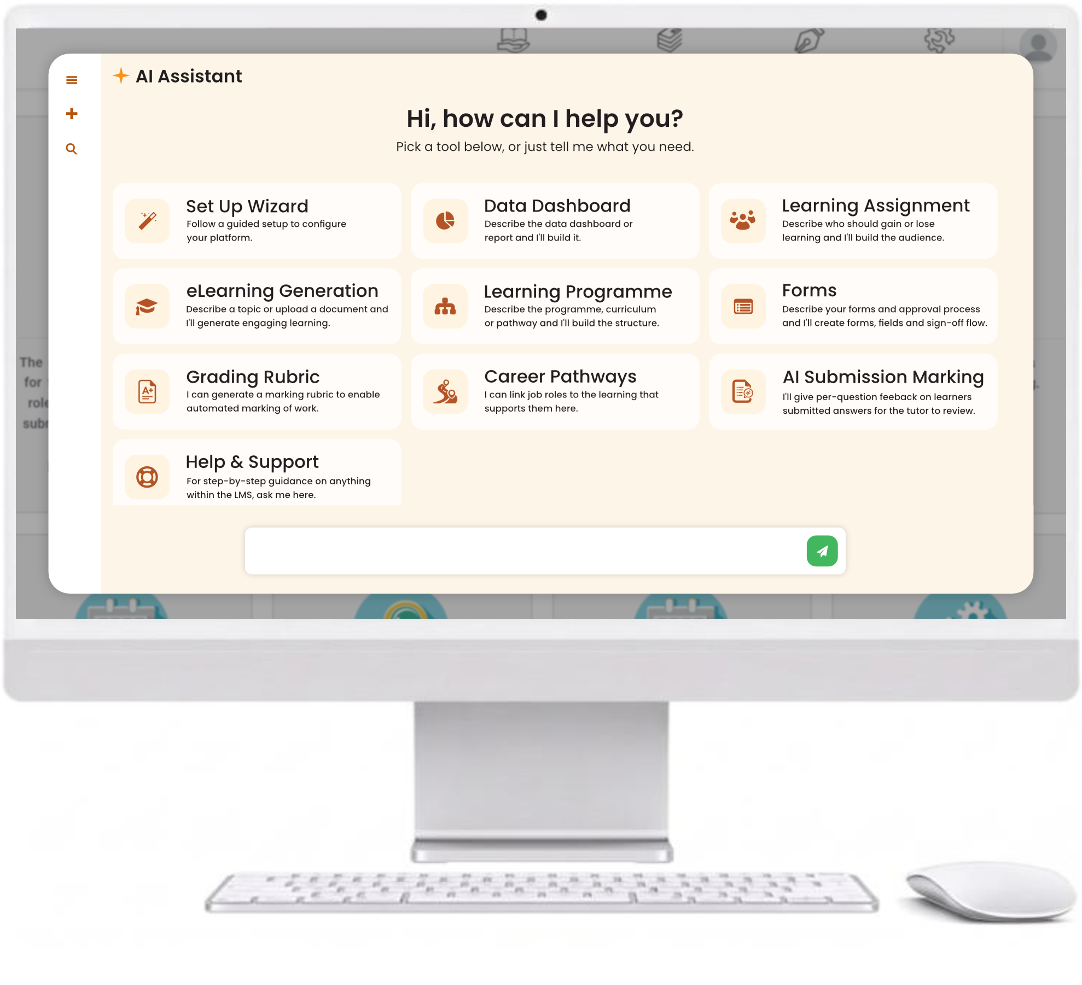
AI is not an enhancement… it is the solution
Emil Reisser-Weston, MSc MEng
Managing Director, Open eLMS
Notes:
Hello, my name is Emil Reisser-Weston and I’m the Managing Director of Open eLMS. Give me 20 minutes and I’ll show you why AI is not an enhancement to learning production: it is the solution. This will change the way you produce learning in your organisation.

Slide 2

Background
PART ONE
Who we are, and why it gives our message its strength.
Notes:
Before I talk about Open eLMS AI, I’d like to tell you something about the background of our company. It contributes a great deal to the strength and credibility of our message.

Slide 3
Two decades at the forefront of eLearning
OVERVIEW
LMS since 2003
Authoring system since 2007
Top Performer on SourceForge and Slashdot, Summer 2026
First LMS for apprentices
The only LMS that creates its own learning
One supplier for the whole learning solution
23+
5,500+
Years of innovation
eLearning courses
28
4.9
Languages
Capterra rating
openelms.com
Notes:
Open eLMS has been going since 2003, and we’ve had an authoring system since 2007. This summer we were again named a Top Performer by SourceForge and Slashdot, two peer review sites, and we hold a 4.9-star rating on Capterra. We were the first learning management system built for apprenticeships, we’re the only LMS that creates its own learning, and we now have more than 5,500 eLearning courses available in 28 languages. In short, we’re a one-supplier learning solution, from app to LMS. We are not a start-up with a solution looking for a problem: we have lived in this industry for more than 23 years and been at the forefront of its development.

Slide 4




Everything from content to LMS
ONE SUPPLIER
The AI-powered LMS, 23 years in development.
eLearning, podcasts, videos, games and PowerPoint from prompts or documents.
More than 5,500 editable courses in 28 languages.
Project management, finance, marketing and HR beside your LMS.
openelms.com
Notes:
Open eLMS is one supplier for the whole learning solution. The LMS has been in development for 23 years. The Learning Generator turns prompts and documents into eLearning, podcasts, videos, games and PowerPoint. The eLearning Store has more than 5,500 editable courses in 28 languages. And Open eLMS OS adds project management, finance, marketing and HR modules alongside your LMS.

Slide 5








Trusted across the public and private sectors
CLIENTS
Councils
Emergency services
Housing associations
Transport
Legal
FMCG
Universities
Central government
openelms.com
Notes:
Our clients span every kind of organisation: councils, emergency services, housing associations, transport, legal, FMCG, universities and central government.

Slide 6
Enterprise-grade security and compliance
CERTIFICATIONS & STANDARDS
ISO 27001
ISO 9001
ISO 20000
Information security
Quality
IT service management
Cyber Essentials Plus
CPD Certified
LTI v1.3
Security
Continuing professional development
Interoperability
UK Training Provider Number 10002082 · HMRC Learning and Training Services supplier
openelms.com
Notes:
We hold ISO 27001, ISO 9001 and ISO 20000 certification, Cyber Essentials Plus and CPD accreditation, and we’re built to LTI v1.3. We’re a registered UK training provider and an approved UK government supplier.

Slide 7
The journey
PART TWO
How we got here explains why Open eLMS AI is unique in the industry.
Notes:
That’s who we are. But I think it’s important to tell you the journey of how we got to where we are today, because it explains how the Open eLMS AI system is produced and why it is unique in the industry.

Slide 8
eLearning that looks like a documentary
THE JOURNEY
2003
We began as an eLearning developer with a simple LMS for clients who had none. To make learning that felt like a documentary, we built our own framework: video presenters shot on green screen, combined with interactive elements. eLearning, not e-reading.
to 2007
openelms.com
Notes:
In 2003 we started as an eLearning development company with a learning management system: a simple system for clients who didn’t have LMSs in those days. We wanted to produce highly effective eLearning, eLearning that looked more like a documentary than a PowerPoint presentation. To do that we built our own framework, combining video presenters shot on green screen with interactive elements. The result was an immersive, documentary style rather than text plus image, a style still common today. In other words, more of an eLearning than an e-reading experience.

Slide 9
Editing in the browser, years ahead
THE JOURNEY
2008
We built eLearning for FTSE 100 companies and for local and central government, and moved our tool into the browser so designers could edit from anywhere. Articulate took another seven years to follow.
to 2022
openelms.com
Notes:
We kept developing the system, producing eLearning for some of the top organisations in the UK, including FTSE 100 companies and local and central government. Along the way we added features and moved the tool online so it could be edited in the browser, something it took Articulate a further seven years to emulate. For the first time, eLearning developers could edit their courses anywhere, without their software or their work computer. That approach is now common to most systems, Adobe apart.

Slide 10
But there was a problem
A PROBLEM
And it can be summed up in a single sentence.
Notes:
However, there was a problem, and in a nutshell it can be summed up as…

Slide 11
A paintbrush and an easel does not make an artist
“
Notes:
“A paintbrush and an easel does not make an artist.” In other words, we could give people the tools to create great learning, but without design experience they couldn’t produce a professional eLearning design. Let me show you why.

Slide 12

Recreating PowerPoint
DESIGN FAILING 1 OF 4
Designers stuck in the PowerPoint habit put bullet points on a whiteboard background. No illustration of concepts, no multimedia.
Result: e-reading, not eLearning.
openelms.com
Notes:
Many learning designers were stuck in the old PowerPoint paradigm. They had a tool that was as easy to use as PowerPoint, so they produced PowerPoint slides: a whiteboard background with bullet-point text on top. That’s an e-reading exercise, not an eLearning exercise. There’s no illustration of concepts and no multimedia; you may as well give someone a book to read.

Slide 13
Lack of diversity
DESIGN FAILING 2 OF 4
Designers found one template they liked and used it again, and again, and again.
Result: boring, samey courses.
openelms.com
Notes:
In other cases designs lacked diversity. Designers would find one template they liked and use it again and again and again, so the software produced very boring, very samey courses.

Slide 14
Image errors
DESIGN FAILING 3 OF 4
Stretched images give an unreal, uncanny look. Easy to avoid, and yet so common.
Result: an amateur finish.
openelms.com
Notes:
Image errors like this really infuriate designers, because they’re so easy to avoid but oh so common. The image has been stretched, and it gives an unreal, uncanny look.

Slide 15
Typography errors
DESIGN FAILING 4 OF 4
Text pasted straight from documents: mixed sizes and fonts, and sometimes too small to read at all.
Result: inaccessible learning.
openelms.com
Notes:
We also found typography errors. Users would cut and paste text straight from documents into the system, giving text of different sizes and fonts, and in some cases text so small it was inaccessible. So, in a nutshell, leaving too much to the novice designer wasn’t the best way to produce professional-standard eLearning.

Slide 16
Could AI be the solution?
IT’S A MESS
Notes:
To be honest, a lot of the eLearning the system produced was a mess. But could AI be the solution to these design nightmares?

Slide 17
Putting AI to the test
THE JOURNEY
2022
Our design team first used AI in computer-based training back in 1993. In 2022 we asked a new question: could AI now create learning on its own? We opened ChatGPT and asked it for an eLearning script.
the experiment
openelms.com
Notes:
Our design team had actually used AI in the early days of computer-based training in 1993, but AI has come a long way since then. In 2022 we decided to find out whether, in theory, AI could be used to create learning. So we loaded up ChatGPT, gave it a prompt to produce an eLearning script, and voilà.

Slide 18

AI can write the script
THE EXPERIMENT · 1 OF 4
The script was genuinely good: a course overview, learning objectives and, with follow-up questions, the script for every screen.
“There are two kinds of script writer: those who use AI, and those who don’t admit it.”
openelms.com
Notes:
It produced a script that was really, really good. It had a course overview and learning objectives, and when we asked follow-up questions it expanded on those objectives and wrote the script for every single screen. The overall result was excellent. I was chatting to an SME script writer the other day and he said there are two kinds of script writer: those who use AI to help write scripts, and those who don’t admit to using it.

Slide 19

AI can create the images
THE EXPERIMENT · 2 OF 4
Image generation leapt forward between 2022 and 2023. No more stock libraries or Photoshop composites: exactly the image you need, every time.
From rough sketch to photo-real in twelve months.
openelms.com
Notes:
Then we looked at generating images with AI. Image generation advanced hugely over that year. Compare an image of a blue bike made at the start of 2022 with one made at the start of 2023: the improvement is obvious. It was clear that rather than creating images from stock or amalgamating them in Photoshop, that whole process simply wasn’t needed any more. We could produce exactly the image we wanted, every time, using AI.

Slide 20

AI can speak the voiceover
THE EXPERIMENT · 3 OF 4
Instead of studio recordings, we found an AI voice engine with natural intonation that sounds completely human.
The only giveaway: there are no mistakes.
openelms.com
Notes:
Voiceover was the next thing we needed AI to produce, rather than recording it in a studio. We tried various AI engines and found one that produced a completely accurate voice rendition, including the intonation and everything else that makes speech sound natural, which is amazing. You cannot tell that Open eLMS AI voiceovers weren’t made by human beings, apart from the fact that there are no mistakes.

Slide 21

AI can repurpose existing learning
THE EXPERIMENT · 4 OF 4
Give it documents, PowerPoints, or Articulate and Elucidat courses, and AI rebuilds them as new, immersive eLearning.
Old content becomes new learning in minutes.
openelms.com
Notes:
Finally, we looked at whether AI could repurpose learning that already exists. It can: give it your documents, PowerPoint decks, company knowledge, or even Articulate and Elucidat courses, and it rebuilds them as new, professional, branded eLearning in minutes.

Slide 22
AI is not an enhancement, it’s the only way forward
PART THREE · THE BIG IDEA
Notes:
From this work the big idea soon became clear. AI is not going to be merely an enhancement added to an existing authoring system. Instead, AI should be the solution to the entire process of eLearning generation.

Slide 23
The Learning Generator launches
2023
One input, many outputs: eLearning, podcasts, videos, mind maps, games and PowerPoint, from a prompt or a document.
openelms.com
Notes:
So in 2023 we launched Open eLMS AI, now the Open eLMS Learning Generator. One input, many outputs: from a prompt or a document it produces eLearning, podcasts, videos, mind maps, games and PowerPoint.

Slide 24



Built to fix traditional eLearning failings
THE BRIEF
Failed designs
Lengthy production times
High costs
Outdated learning experiences
openelms.com
Notes:
The system was designed specifically to overcome the traditional eLearning failings we saw with our previous Open eLMS Creator product. It overcomes failed designs and lengthy production times, it reduces costs dramatically, and it eliminates outdated learning experiences: it replaces e-reading with immersive eLearning.

Slide 25




AI-powered eLearning solves these problems
THE ANSWER
Instant content generation
Personalised learning at scale
Cost-effective and efficient
No more design errors
Better, story-like designs
openelms.com
Notes:
Open eLMS AI now solves these problems. We have instant content generation: you can go from document to eLearning in minutes. We have personalised learning at scale: you can create eLearning for one, two or three individuals, so you no longer need generic eLearning. You can produce learning on anything, the same way you’d produce a PowerPoint presentation, only quicker. It’s cost-effective and efficient, costing a couple of pounds per course. And it eliminates design errors, because good design is embedded in the product, with better, immersive, story-like designs.

Slide 26
The AI objections, and the truth
PART FOUR · BREAKING FALSE BELIEFS
Notes:
Before you decide to trust AI with your learning, we need to address the concerns people have about it. There will be objections, so let’s go through them and explain the truth behind each one.

Slide 27

“AI can’t create engaging content.”
MYTH 1 OF 5
THE TRUTH
AI generates interactive, photo-real and personalised learning in a story-like format.
openelms.com
Notes:
The first objection is that AI can’t create engaging content. In fact, AI generates interactive, photo-real and personalised learning experiences in a storytelling format. That is truly immersive eLearning, and it is both engaging and highly effective.

Slide 28
“I don’t trust AI-generated courses.”
MYTH 2 OF 5
THE TRUTH
AI works alongside human expertise, and you keep full editorial control.
openelms.com
Notes:
The second myth is that people don’t trust AI courses. AI works alongside human expertise to ensure top-quality content, with full editorial control. AI may occasionally hallucinate or get things wrong, but you have complete control to change the text to say whatever you want. In fact, AI tends to make fewer errors than people do, and it keeps improving as we train it further.

Slide 29
“AI-produced eLearning won’t be effective.”
MYTH 3 OF 5
THE TRUTH
98%
Independent studies with more than 100 participants rate it more engaging and effective than traditional courses.
approval rate
openelms.com
Notes:
Another concern is that AI-produced eLearning won’t be effective. Independent studies involving more than 100 participants have shown a 98% approval rate, demonstrating that AI-generated content is more engaging and effective than traditional courses.

Slide 30
“Designers and developers will lose their jobs.”
MYTH 4 OF 5
THE TRUTH
AI doesn’t replace designers: it frees them to focus on interactions and media.
openelms.com
Notes:
There’s a fear that designers and developers will lose their jobs. In reality AI doesn’t replace them; it empowers instructional designers to focus on the interactions and media within the learning experience. You can create full video productions and embed them in the learning. Open eLMS AI lets you produce more targeted learning without eliminating the role of learning designers.

Slide 31
“My existing software will do this soon.”
MYTH 5 OF 5
THE TRUTH
Open eLMS isn’t just software: it’s 23 years of eLearning design experience, delivered through AI.
openelms.com
Notes:
And finally: “My existing software will do this soon.” Open eLMS is not just software. It is 23 years of eLearning design experience, embedded into a product through AI. And it’s not only the experience; it’s also the media we as a company have been producing for the last 23 years. That media is encoded, categorised and delivered to you through AI-generated eLearning. It’s not a software application; it’s an eLearning generation system.

Slide 32
Why Open eLMS AI is different
PART FIVE · THE NEW OPPORTUNITY
Notes:
Since 2003 we have been involved in every aspect of eLearning. I’m a qualified ergonomist and have worked in eLearning since 1993. Our philosophy of user-friendliness led us to design our own tools, culminating in Open eLMS. We produce everything in house, in the UK and at our production office in Latvia, which makes us agile to your requirements.

Slide 33



What makes it different
A REVOLUTION IN ELEARNING
Automates the whole course: design, voiceovers and interactivity
AI trained on 23 years of eLearning expertise
Used by government agencies and organisations worldwide
A unique story-mode design method, made for AI
openelms.com
Notes:
This is a brand-new opportunity in how we create learning. So why is Open eLMS AI so different? Let’s recap what it delivers. It automates the entire course creation process, including design, voiceovers and interactivity. It uses 23 years of eLearning expertise to train the AI for the best results. It’s used by top government agencies and organisations worldwide. And it delivers eLearning through a unique story-mode design method, ideally suited to AI and the imagery it generates.

Slide 34
Eleven reasons to join us
WHAT YOU GET
01 AI course generator: multimodal eLearning
07 Translations: into any language
02 Image library: 150,000+ images and growing
08 Help and support: free training and AI help
03 AI image generation: images of anything
09 Multichannel learning: games, PowerPoint, video
04 Animations library: 23 years of in-house work
10 AI integration: ask the LMS anything
05 Design heuristics: AI trained by the best
11 Editor: powerful editing in the browser
06 Presenters and voiceovers: hyper-realistic
openelms.com
Notes:
So, what do you get when you join us? Eleven things, and I’ll take you through each one in turn.

Slide 35
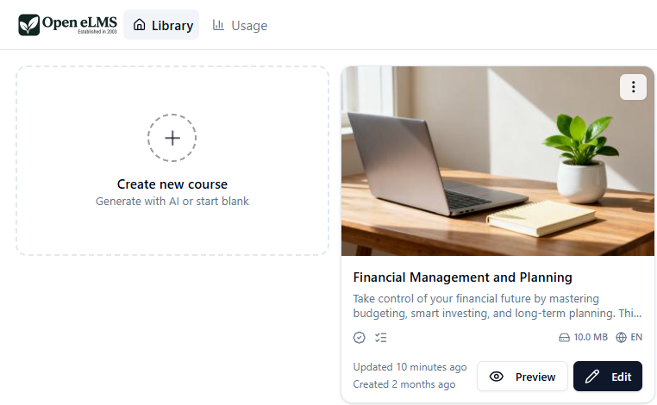
AI course generator: multimodal eLearning
WHAT YOU GET · 01 OF 11
Designed eLearning with video, audio and imagery, produced for you at the press of a button.
openelms.com
Notes:
So, what do you get when you join us? First, you get an AI-powered course generator that produces multimodal learning: designed eLearning with video, audio and imagery, all produced for you at the press of a button. It starts right here in the library: Create new course, generate with AI or start blank.

Slide 36
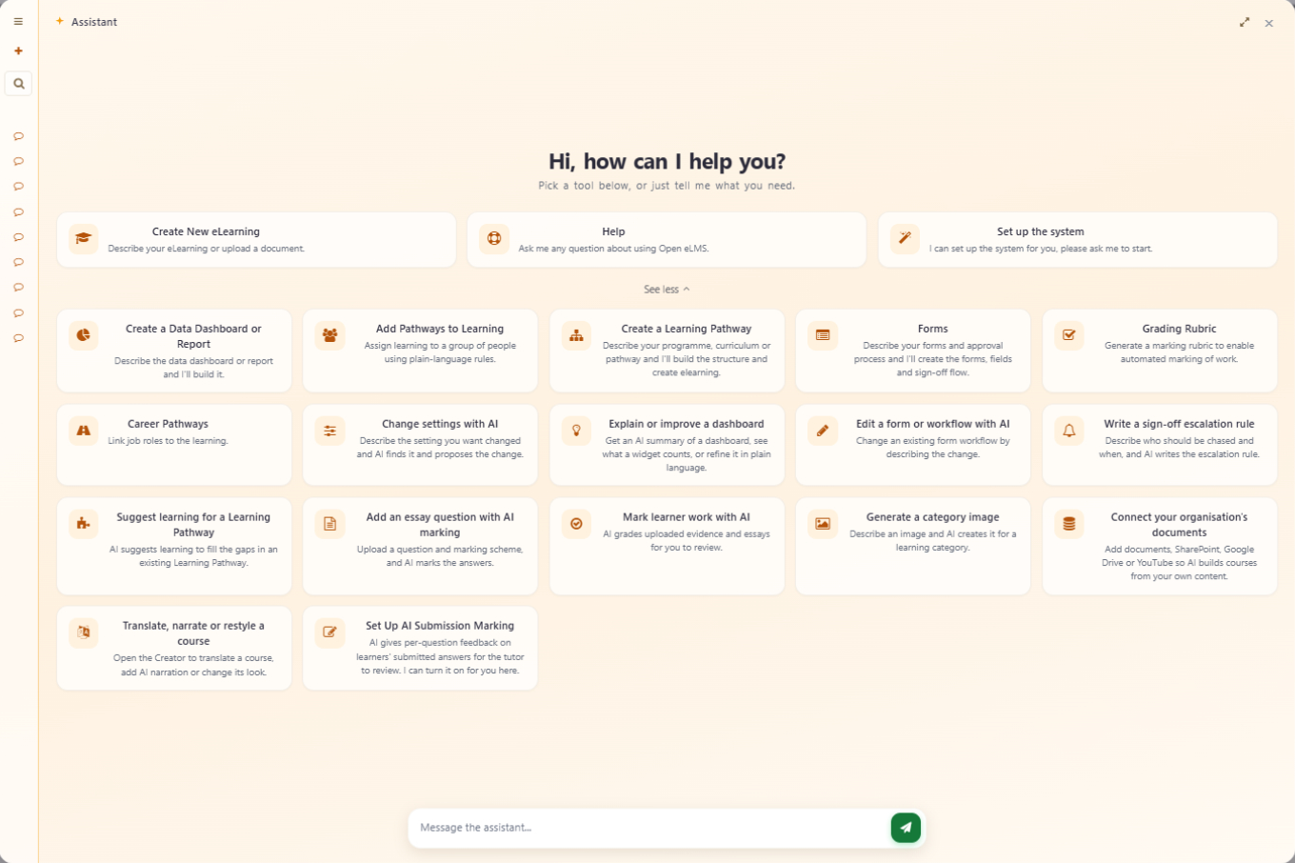
Describe it, or upload a document
WHAT YOU GET · 01 OF 11
Enter the course description and objectives, or upload a Word, PDF or PowerPoint file.
openelms.com
Notes:
We enter the description and the objectives of the learning course, or simply upload a document: Word, PDF or PowerPoint all work.

Slide 37
Press generate, and it’s done
WHAT YOU GET · 01 OF 11
2–10
The finished eLearning arrives in minutes, and you get an email the moment it’s ready.
minutes per course
openelms.com
Notes:
Then we press generate. Within 2 to 10 minutes the eLearning is produced, and you get an email when it’s done.

Slide 38
Image library, and growing
WHAT YOU GET · 02 OF 11
150,000+
The AI uses them when it generates a course, and you can search them by text in the editor and drop any image straight into your learning.
images, plus 2,000–3,000 a week
openelms.com
Notes:
You also get an image library of more than 150,000 images, growing by 2,000 to 3,000 images a week. The AI uses these images when it generates courses, and you can use them in the editor too: find any image with a text search and put it straight into the learning.

Slide 39
AI image generation: images of anything
WHAT YOU GET · 03 OF 11
1
2
3
Describe
Generate
Insert
Type what you need, such as a polar bear in the desert playing with balloons.
The AI creates the image afresh, on brand, in seconds.
It drops straight into your eLearning, replacing the image that was there.
openelms.com
Notes:
You also get AI image generation, so you can create images of anything you want. If the AI hasn’t produced a suitable image, type in a description and generate the image afresh. Here, for example, we generated a polar bear in the desert playing with balloons, and that image can then be inserted straight into your eLearning presentation, replacing whatever image was there before.

Slide 40
Animations library: 23 years in house
WHAT YOU GET · 04 OF 11
1,000+
The AI places them naturally: the sun in the sky, smoke rising from a fire. Scenes gain life and depth.
animations and growing
openelms.com
Notes:
You also get an animations library, the product of 23 years of in-house development, with more than 1,000 animations and growing. Every animation Open eLMS has produced is in the system. You can search it by text and add animations straight into the learning. Better still, the AI design engine uses the animations itself and places them in scenes naturally: the sun in the sky, smoke rising from a fire, and so on. It adds environmentally suitable animations where they fit, which gives images life and depth and makes a far more immersive learning experience. It also adds icons and other animations to illustrate key concepts.

Slide 41
Design heuristics: AI trained by the best
WHAT YOU GET · 05 OF 11
23 years of designs became rules the AI design engine follows, so the layout adapts to every scene.
SPACE ON THE LEFT
MORE FLOOR IN VIEW
The presenter stands in mid shot.
A long shot, entering from the right.
openelms.com
Notes:
That brings us to our design heuristics: the AI is trained by some of the best designers in the business. We’ve fed in designs from more than 23 years to create rules the AI design engine follows. For example, take two screens. In one there’s more space on the left-hand side and the presenter is in mid shot. In the other there’s more space and floor in view, so the presenter is in long shot and enters from the right-hand side of the screen. The design adapts to its environment and produces the best result in any situation.

Slide 42

Presenters and voiceovers: hyper-realistic
WHAT YOU GET · 06 OF 11
AI lip-synced presenters introduce every course and congratulate learners at the end, in any language.
More attention, better encoding, better recall.
openelms.com
Notes:
Video presenters and voiceovers are hyper-realistic. Presenters introduce each course and appear again at the end to congratulate the learner on finishing. They give the learning salience and immersion: people feel they are entering a virtual learning world rather than watching a two-dimensional presentation. From a cognitive psychology perspective, that extra engagement brings greater attention, and so better encoding of the learning content, which leads to better learning and recall.

Slide 43
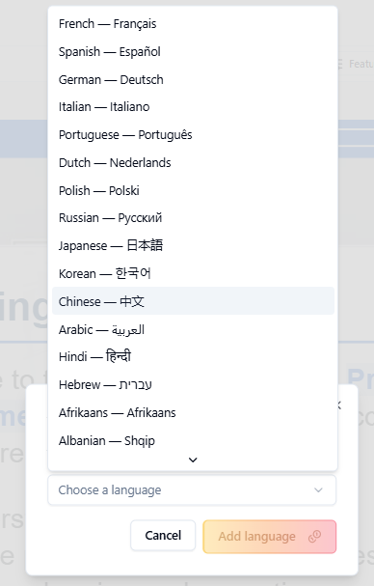
Translations: into any language
WHAT YOU GET · 07 OF 11
Translate the whole course, voiceovers and presenters included, in a single click.
openelms.com
Notes:
Once you’ve added voiceovers and presenters, you can translate them into any language. In fact, the whole course can be translated into any language in a single click. Friends who speak Hindi, Mandarin and Urdu have assured me the translation is perfect.

Slide 44
Help and support: free training and AI help
WHAT YOU GET · 08 OF 11
A free one-to-one training session for Enterprise users, plus an AI assistant with just-in-time advice and video walkthroughs.
openelms.com
Notes:
We also offer help and support, with free training and AI assistance on hand at any time. All Enterprise users get a half-hour one-to-one training session where we teach you how to edit the generated eLearning. You also get the Open eLMS AI Assistant, which gives you just-in-time advice on editing any part of the eLearning once it’s created, with links to video walkthroughs showing how to change each part of the learning. Simply put, there’s no need for any extra training to use the tool.

Slide 45





Multichannel learning: one input, many outputs
WHAT YOU GET · 09 OF 11
eLearning
Videos
Podcasts
PowerPoint
SCORM, ready for any LMS
With AI presenters
Learning on the go
For the classroom
Mind maps
Reports
Arcade games
YouTube
A topic at a glance
Training analysis
Revision made fun
Udemy, Podia, Coursera too
openelms.com
Notes:
We can also repurpose the eLearning into many other formats for delivery in the classroom, on YouTube or for revision. You change a setting and the same eLearning can be experienced in different formats inside the course, or delivered outside it: as a video with AI presenters, a podcast, a PowerPoint deck for classroom presentations, a mind map, a training analysis report, or arcade-style games. You can even publish to Udemy, Podia and Coursera.

Slide 46

Learning as a game
WHAT YOU GET · 09 OF 11
Pick from a choice of arcade games. In our Pac-Man-style game, eating a question mark asks you a question. Learners can even ask the AI about the content. All 100% optional.
Positive rewards and instant gratification.
openelms.com
Notes:
There’s a choice of video games. In this case we have a Pac-Man-style game, where eating a question mark asks you a question: positive rewards and instant gratification. It even lets you talk to the AI to ask questions about the content. All 100% optional.

Slide 47

AI integration: ask the LMS anything
WHAT YOU GET · 10 OF 11
The content uses open, uncompiled data structures, so your LMS can read it and feed your organisation’s AI knowledge.
Every course becomes knowledge your AI can use.
openelms.com
Notes:
In addition, the content uses uncompiled, open data structures, which allow your LMS to read the content and populate your AI knowledge. Learners and managers can then ask the LMS anything about the learning, and the AI answers from your own content.

Slide 48
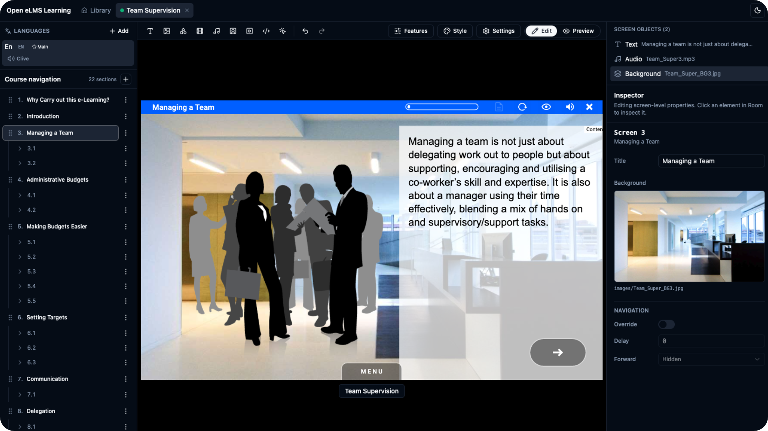
Editor: powerful editing in the browser
WHAT YOU GET · 11 OF 11
Just one part of the whole generation system, so please don’t compare us with buying a traditional authoring tool.
openelms.com
Notes:
Finally, we have powerful editing software that runs in the browser. Notice I’ve only mentioned it at the very end: it’s just one part of the whole eLearning generation system, which is why I don’t want you to compare us with buying a traditional authoring system such as Articulate. Open eLMS is so much more than that.

Slide 49
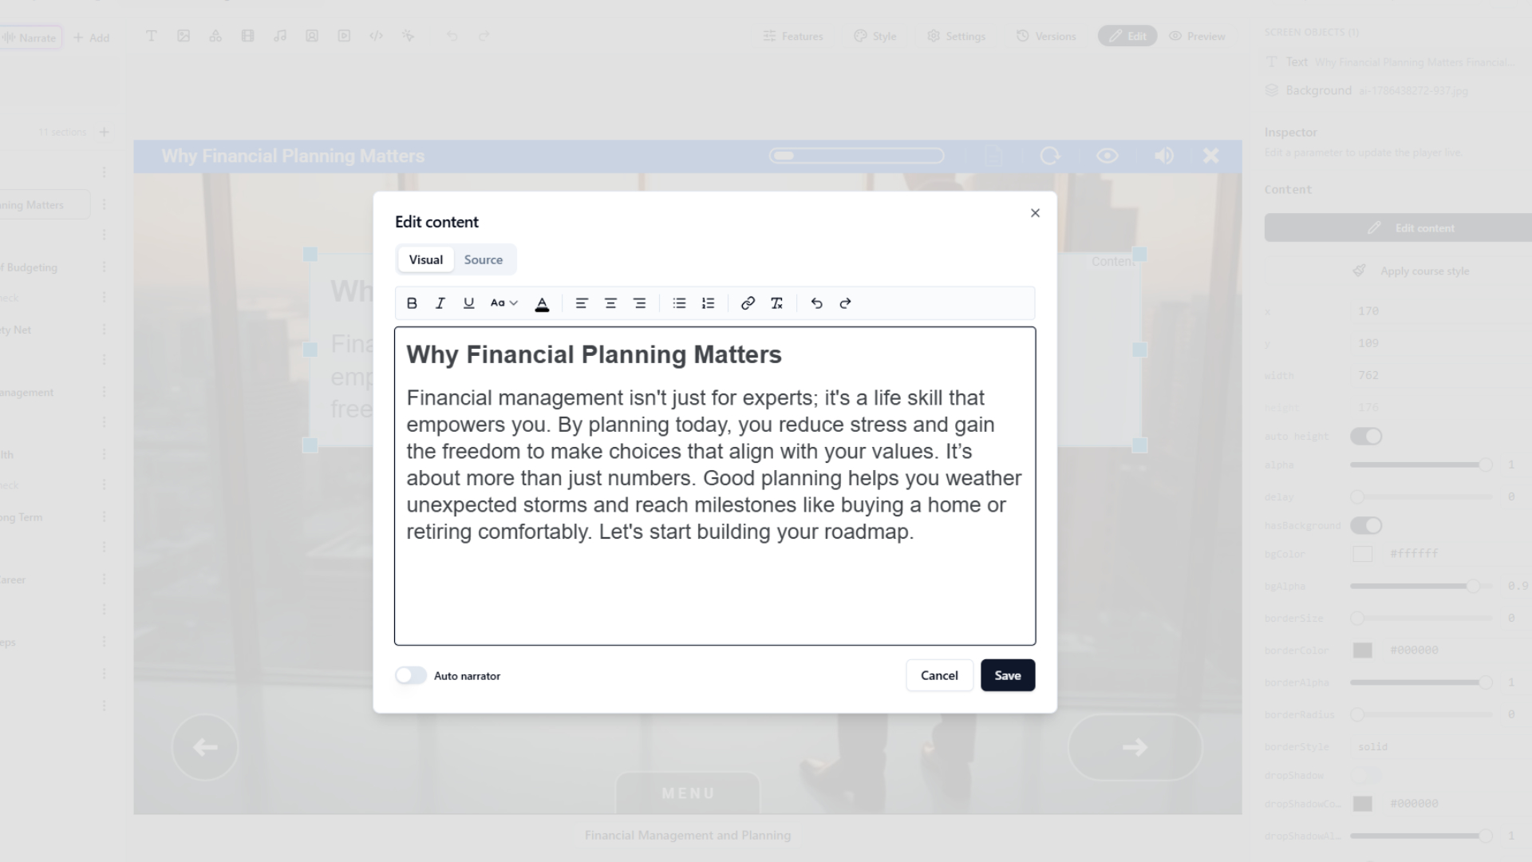
Easy to use, drag and drop
WHAT YOU GET · 11 OF 11
Edit text and move it around, and add buttons that link to pathways or outside resources.
openelms.com
Notes:
That said, it’s really easy to use and has all the features you need. You can edit text and move it around with drag and drop, and you can add buttons that link to pathways or external learning resources.

Slide 50

Everything you expect from an authoring tool
WHAT YOU GET · 11 OF 11
Yes/no questions in the text
Immersive video monitors
Your own images, audio and video
Quizzes, added or edited
Your branding
Narrator voice and accent
In development since 2007.
openelms.com
Notes:
You can add yes/no questions into the body of the text, or bring videos into the learning in a very immersive way: a video monitor comes down onto the screen and plays the video, keeping the whole concept of an immersive learning environment. You can upload any of your own media: video, images and audio. You can add or edit quizzes, and in the learning settings you can change the branding and the narrator’s voice, male or female, and accent. In short, you can do anything you’d expect of an eLearning authoring system in the Open eLMS AI editor, because we’ve been developing it since 2007.

Slide 51
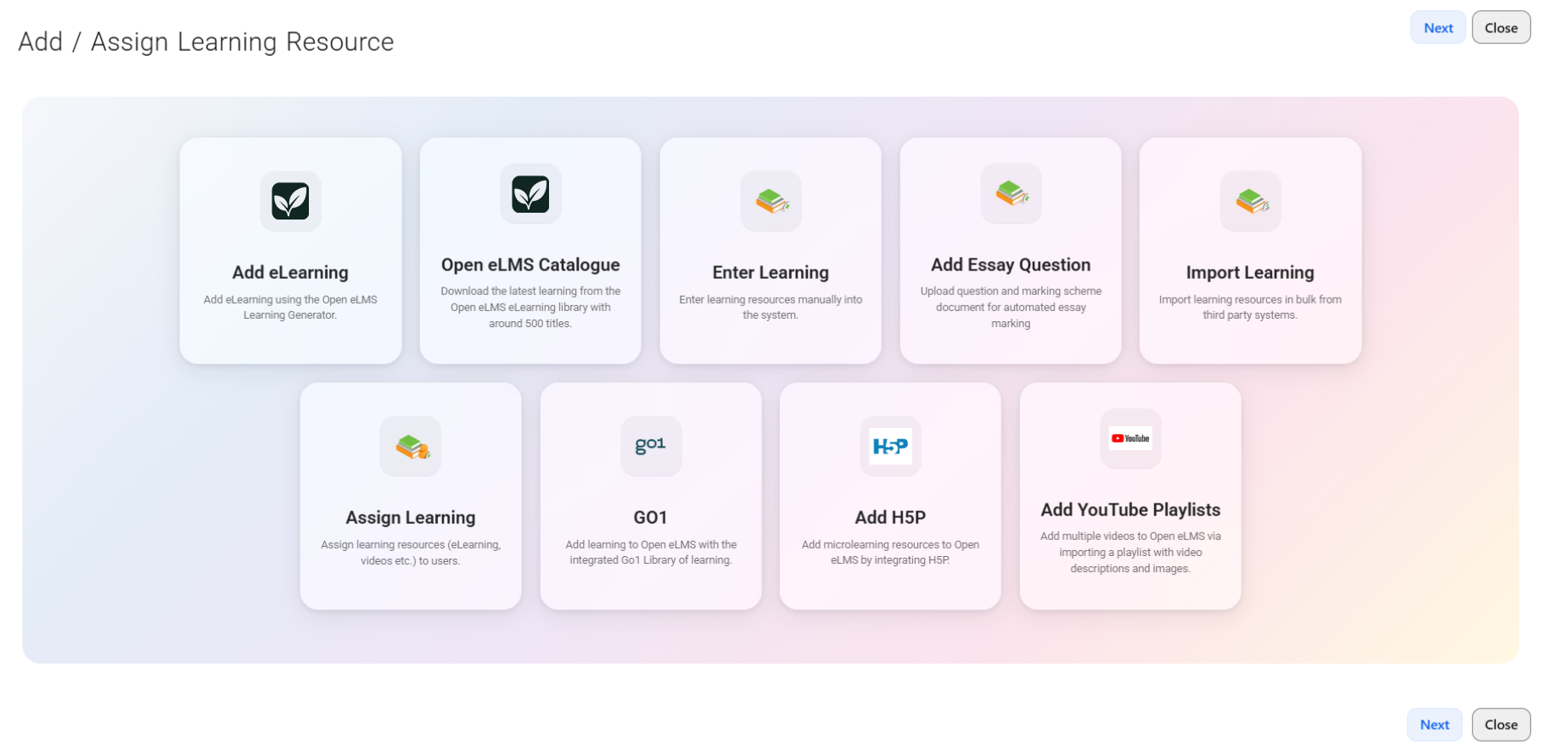
It all lands in your LMS
AND THE LMS
Add learning from the Learning Generator, the catalogue, Go1, H5P or YouTube playlists, then assign it in one place.
openelms.com
Notes:
And because we’re one supplier, everything you create lands straight in your Open eLMS LMS. From one dialog you can add eLearning from the Learning Generator, download courses from the Open eLMS catalogue, enter learning manually, add essay questions with automated marking, import from third-party systems, or bring in Go1, H5P and YouTube playlists, and then assign it to your people.

Slide 52
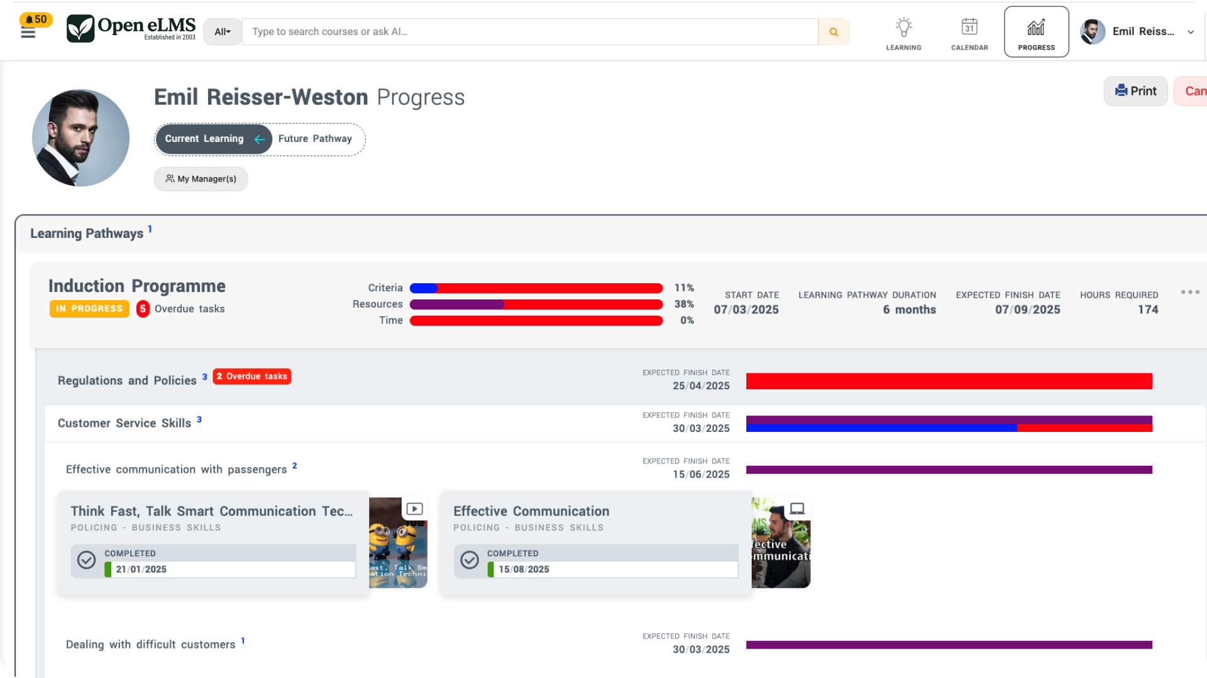
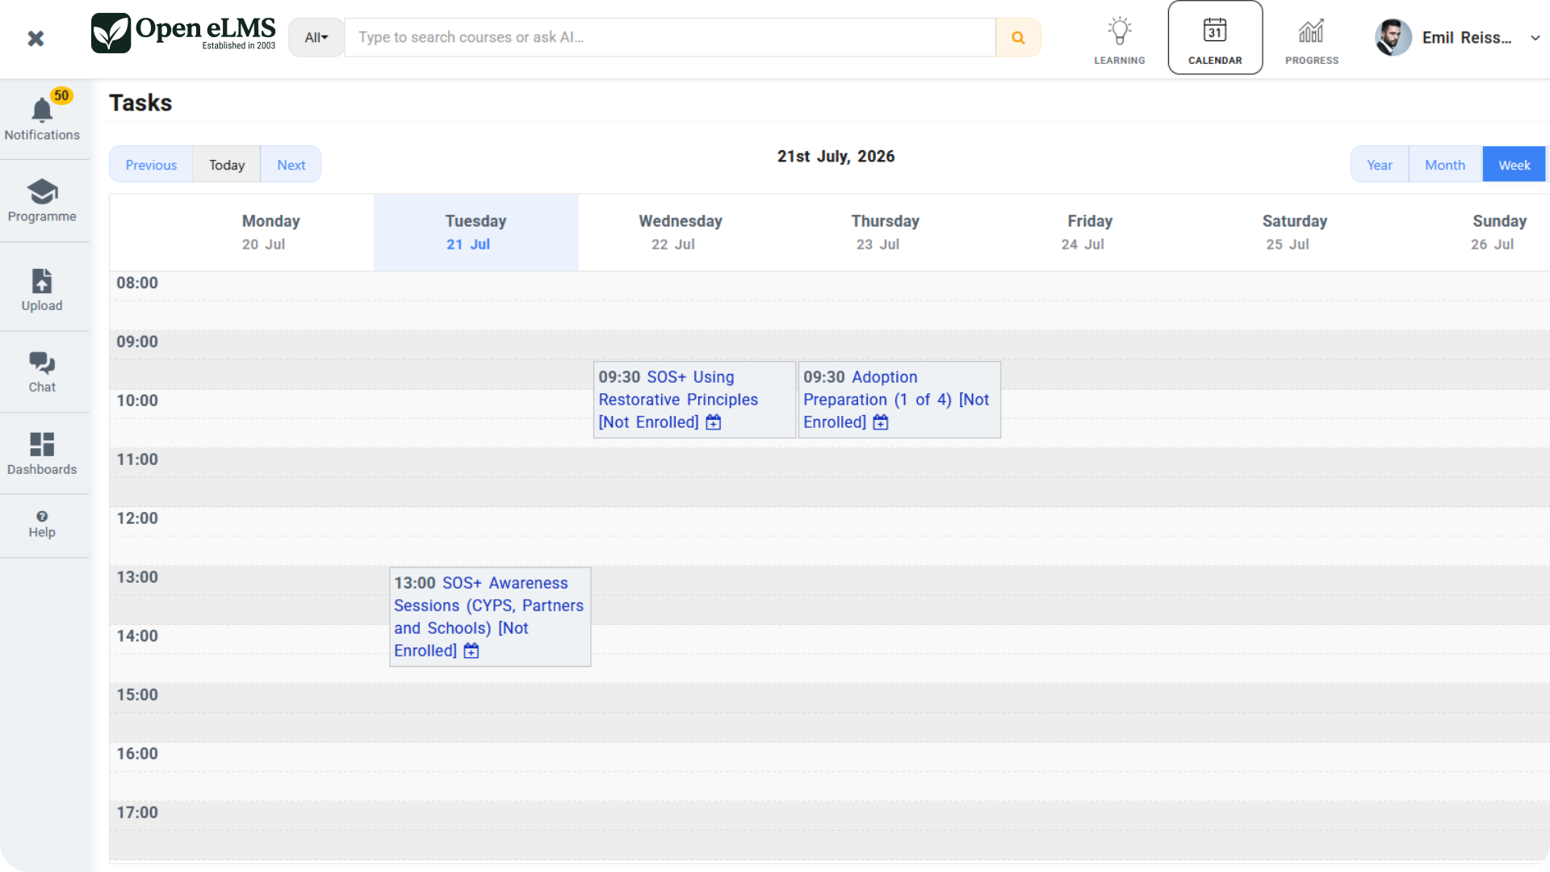
Track progress, schedule learning
AND THE LMS
Learning pathways and progress
Calendar and classroom events
openelms.com
Notes:
Learners and managers can then follow progress through learning pathways, with completion, overdue tasks and expected finish dates, and everyone can see scheduled training and classroom events in the calendar. Microsoft Teams and Zoom sessions can be scheduled, recorded and tracked inside the LMS.

Slide 53
What you get when you join us
TO RECAP
AI course generator
Translations
150,000+ image library
Help and support
THE SAVING
£20,000
AI image generation
Multichannel learning
Animations library
AI integration
£1–2
Design heuristics
Browser-based editor
Presenters and voiceovers
per course, on average
openelms.com
Notes:
So, to recap what you get when you join us: an AI-powered course generator creating multimodal eLearning in minutes; an image library of more than 150,000 images and growing; an AI image generation tool to create images of anything; an animations library from 23 years of in-house development; design heuristics embedded in the AI, trained by the very best designers; hyper-realistic presenters and voiceovers in any language; help and support with free training and AI assistance; multichannel learning; AI integration with your LMS; and a powerful editor in your browser. Astonishingly, the system generates high-end eLearning we would previously have charged clients £20,000 for, and now produces the same thing in minutes for an average of £1 to £2 per course. All possible through the power of AI.

Slide 54
Simple, transparent plans
PRICING
Professional
Enterprise
Enterprise AI
Built for growing teams
For large organisations
Advanced AI capabilities
£10
£35
£69
per user per year
per user per year
per user per year
Custom branding
Unlimited classroom events
200 eLearning credits
AI recommendations
Report Builder and Power BI
Custom domain, priority support
Unlimited eLearning credits
AI chat engine
API and MCP automation
Free to register, with 2,000 free tokens to build your first courses. Prices as listed on openelms.com, October 2026.
openelms.com
Notes:
Our plans are simple and transparent, with no hidden costs. Professional is £10 per user per year, with custom branding, unlimited classroom events and 200 eLearning credits. Enterprise is £35 per user per year and adds AI recommendations, unlimited forms, Report Builder and Power BI, and a custom domain with priority support. Enterprise AI is £69 per user per year, with unlimited eLearning credits, the AI chat engine and API and MCP automation. And you can register free, with 2,000 tokens to build your first courses with AI.

Slide 55
The choice is yours
THE CHOICE
Traditional eLearning | Open eLMS AI
Costly development | Negligible cost
Slow implementation | Rapid development
Generic library content | Targeted learning for real issues
Variable design standards | Consistent, professional, accessible design
One format | Multi-format, any language
openelms.com
Notes:
Costly development, slow implementation, generic library content, variable design standards and one format, versus negligible cost, rapid development, targeted eLearning that deals with real issues, consistent, professional and accessible design, and multi-format learning in any language. The choice is yours: unlimited learning development, in minutes.

Slide 56
Ready to modernise your training?
UNLIMITED LEARNING, IN MINUTES
Get a demo
Contact sales
openelms.com
Notes:
Thank you. If you’d like to see what our AI-powered LMS can do for your organisation, book a demo at openelms.com, or register free and build your first courses today.

